Slide 1

Defining Holistic Protection: A Matrix Sediment Standards Framework
Presenters & Facilitators: Beth Power & Jasen Nelson
Science Advisory Board for Contaminated Sites in BC
Sediment Science and Technical Advisory Committee
Notes:
This presentation, part of the Sediment Management track at CEW 2025, will guide you through the concept of dual sediment standards that protect both benthic organisms and the broader food web. Join us as we consider how to safeguard the complete ecological integrity of British Columbia's diverse aquatic environments.

Slide 2
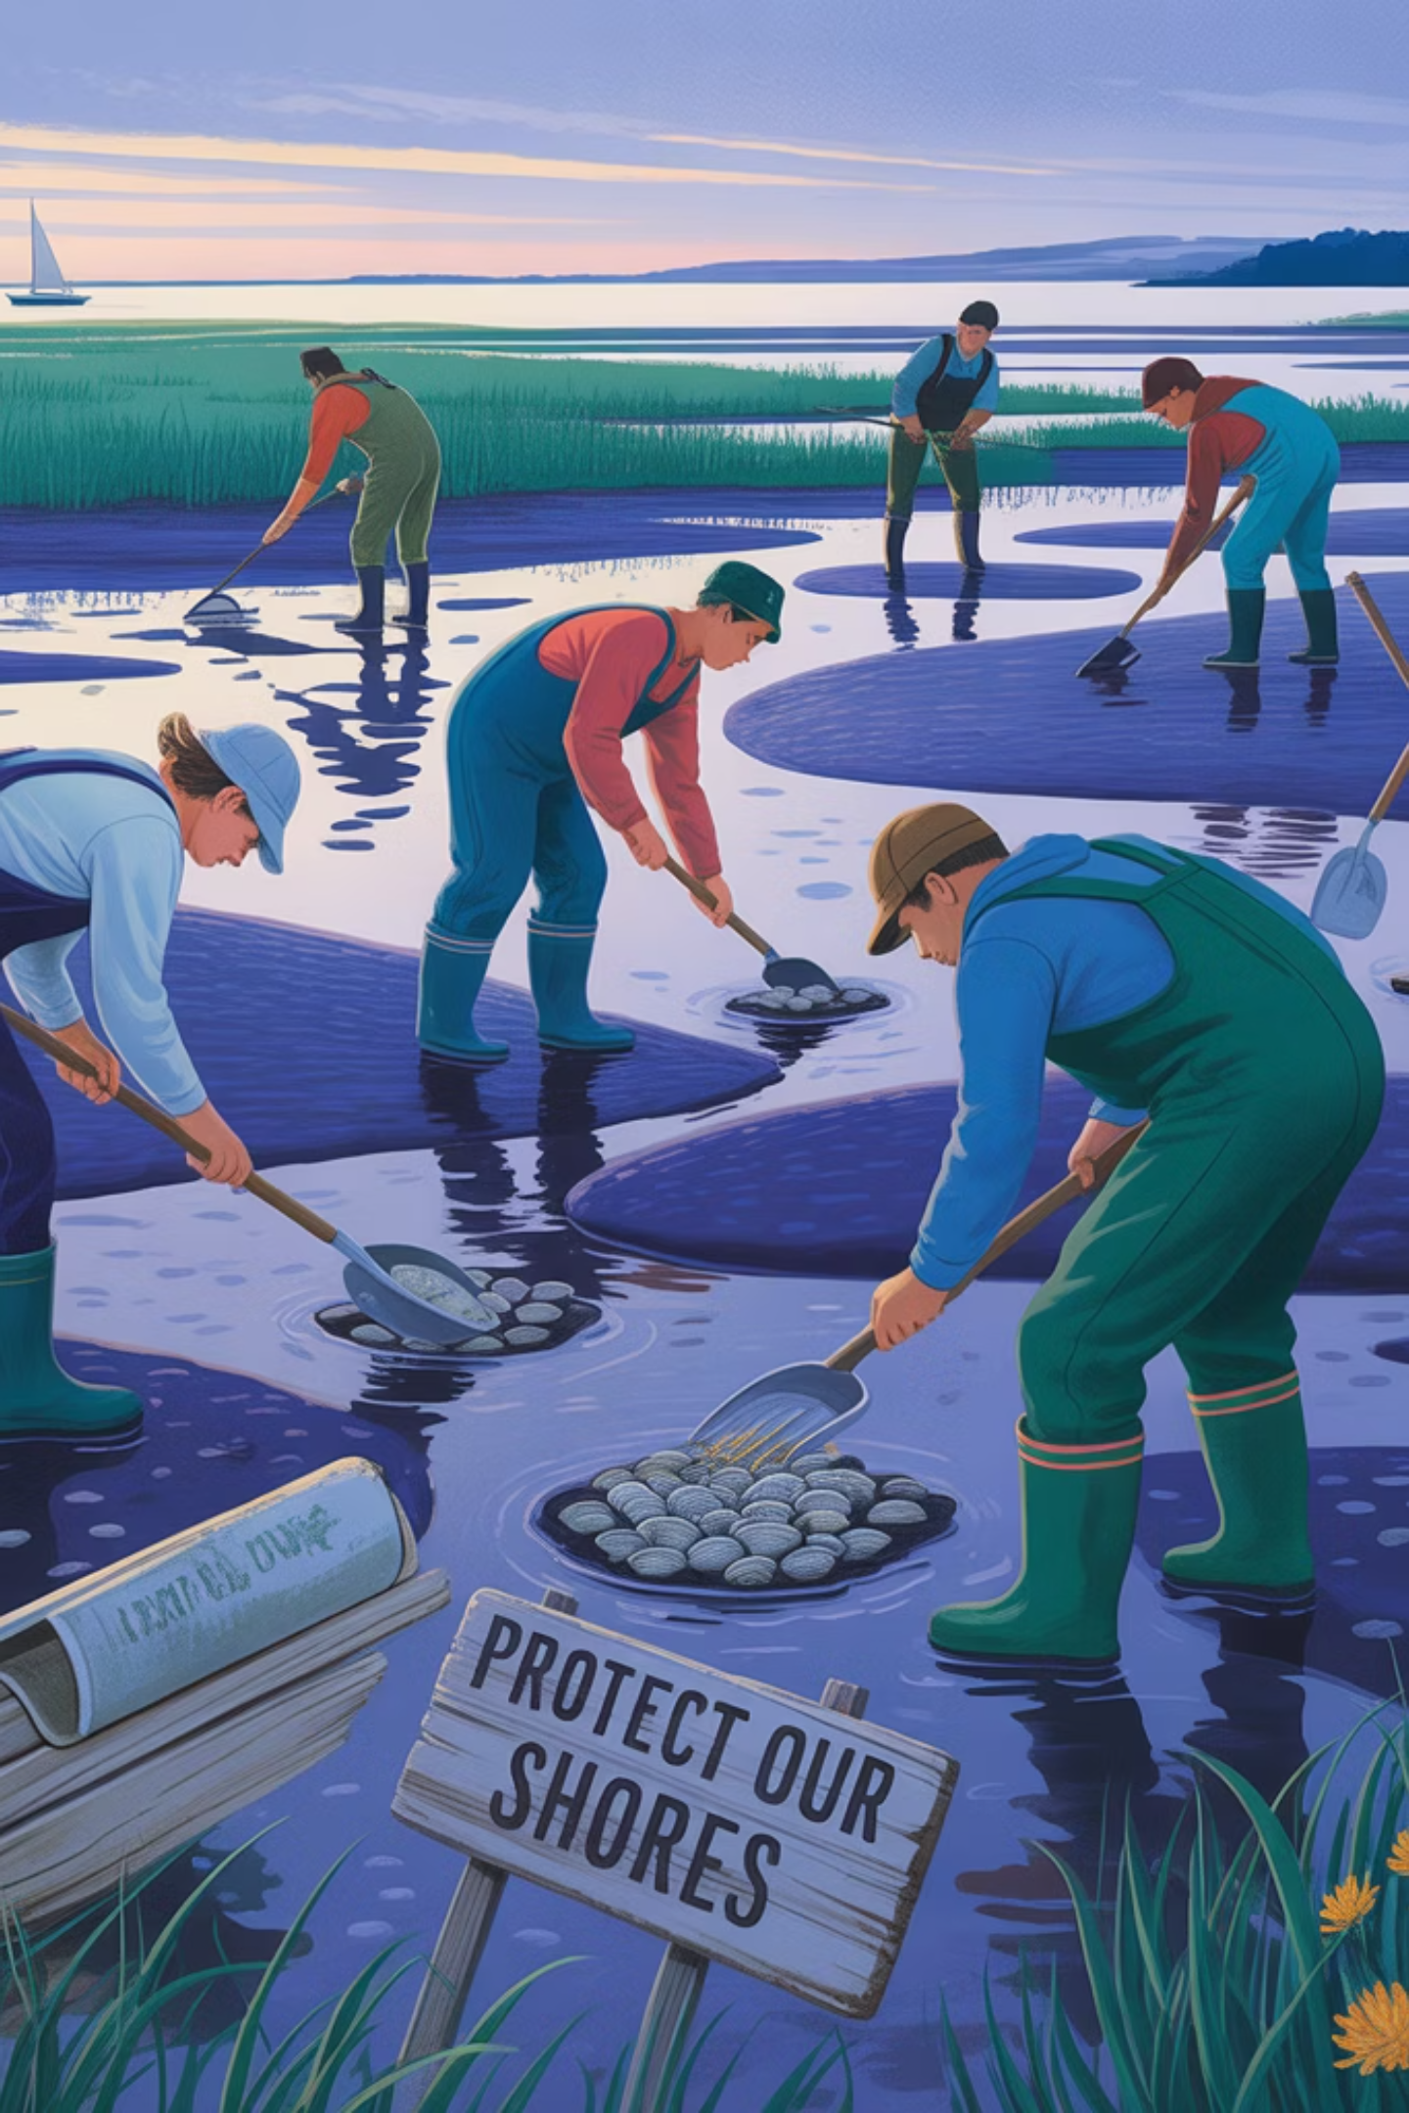



Why "Holistic Protection" Matters for BC Sediments
Direct Toxicity to Amphipods Only
Current standards are based on direct toxicity to amphipods and are assumed to be protective of others.
Ecosystem Integrity
True holistic protection requires ensuring the ecological health of bottom-dwelling and pelagic organisms.
Food Pathway Toxicity
Contaminants move through food webs, affecting fish, birds, wildlife and people that consume aquatic organisms.

Slide 3
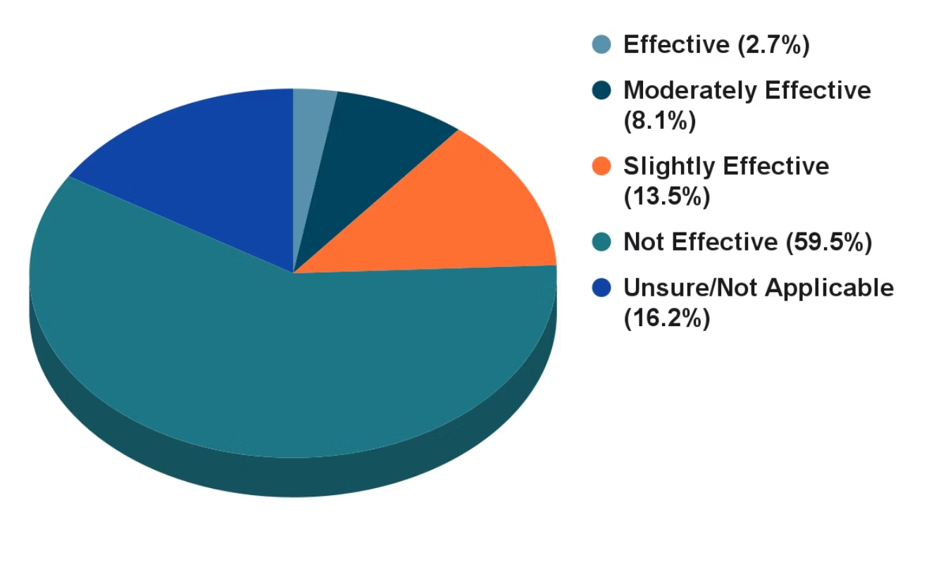
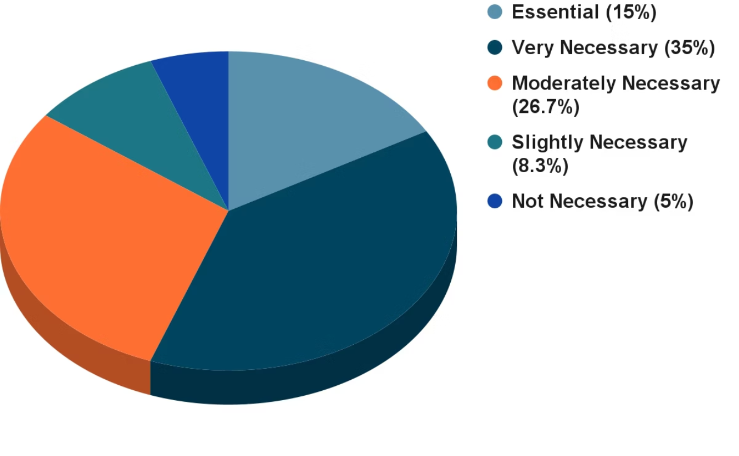
Key Messages from Survey: Bioaccumulation Prevention
73%
76.7%
Current Sediment Standards are Not or Slightly Effective
Necessary in Future Matrix Sediment Standards
"The BC CSR sediment standards are not appropriate or adequate to protect upper trophic level organisms, apex predators and humans at the top of foodwebs, as these sediment standards were or are designed for the protection of low tropic level species and benthic organisms."
"True sediment COCs are not always identified as bioaccumulation is not considered at the investigation stage. This is because bioaccumulation is generally not considered with respect to standards development."

Slide 4

Matrix Sediment Standards (SedS) Framework
Direct Toxicity (SedS-direct)
Food Pathway Toxicity (SedS-food)
SedS-directECO
SedS-foodECO
Protect aquatic organisms from direct exposure from contaminants in sediment.
Protects piscivorous wildlife (e.g., otters, eagles, orcas) from the bioaccumulation and biomagnification of contaminants through the food chain.
SedS-directHH
Protects people from direct contact risks (e.g., incidental ingestion, dermal contact) during recreational or cultural activities.
SedS-foodHH
Protects human consumers of fish, shellfish, and other aquatic foods.

Slide 5
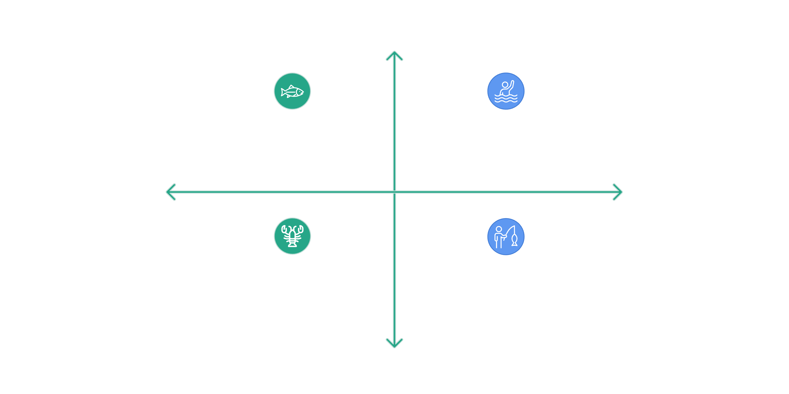




Matrix Sediment Standards (SedS) Framework
Direct Toxicity Exposure
SedS-directECO
SedS-directHH
Ecological Health
Human Health
SedS-foodECO
SedS-foodHH
Food Pathway Toxicity

Slide 6
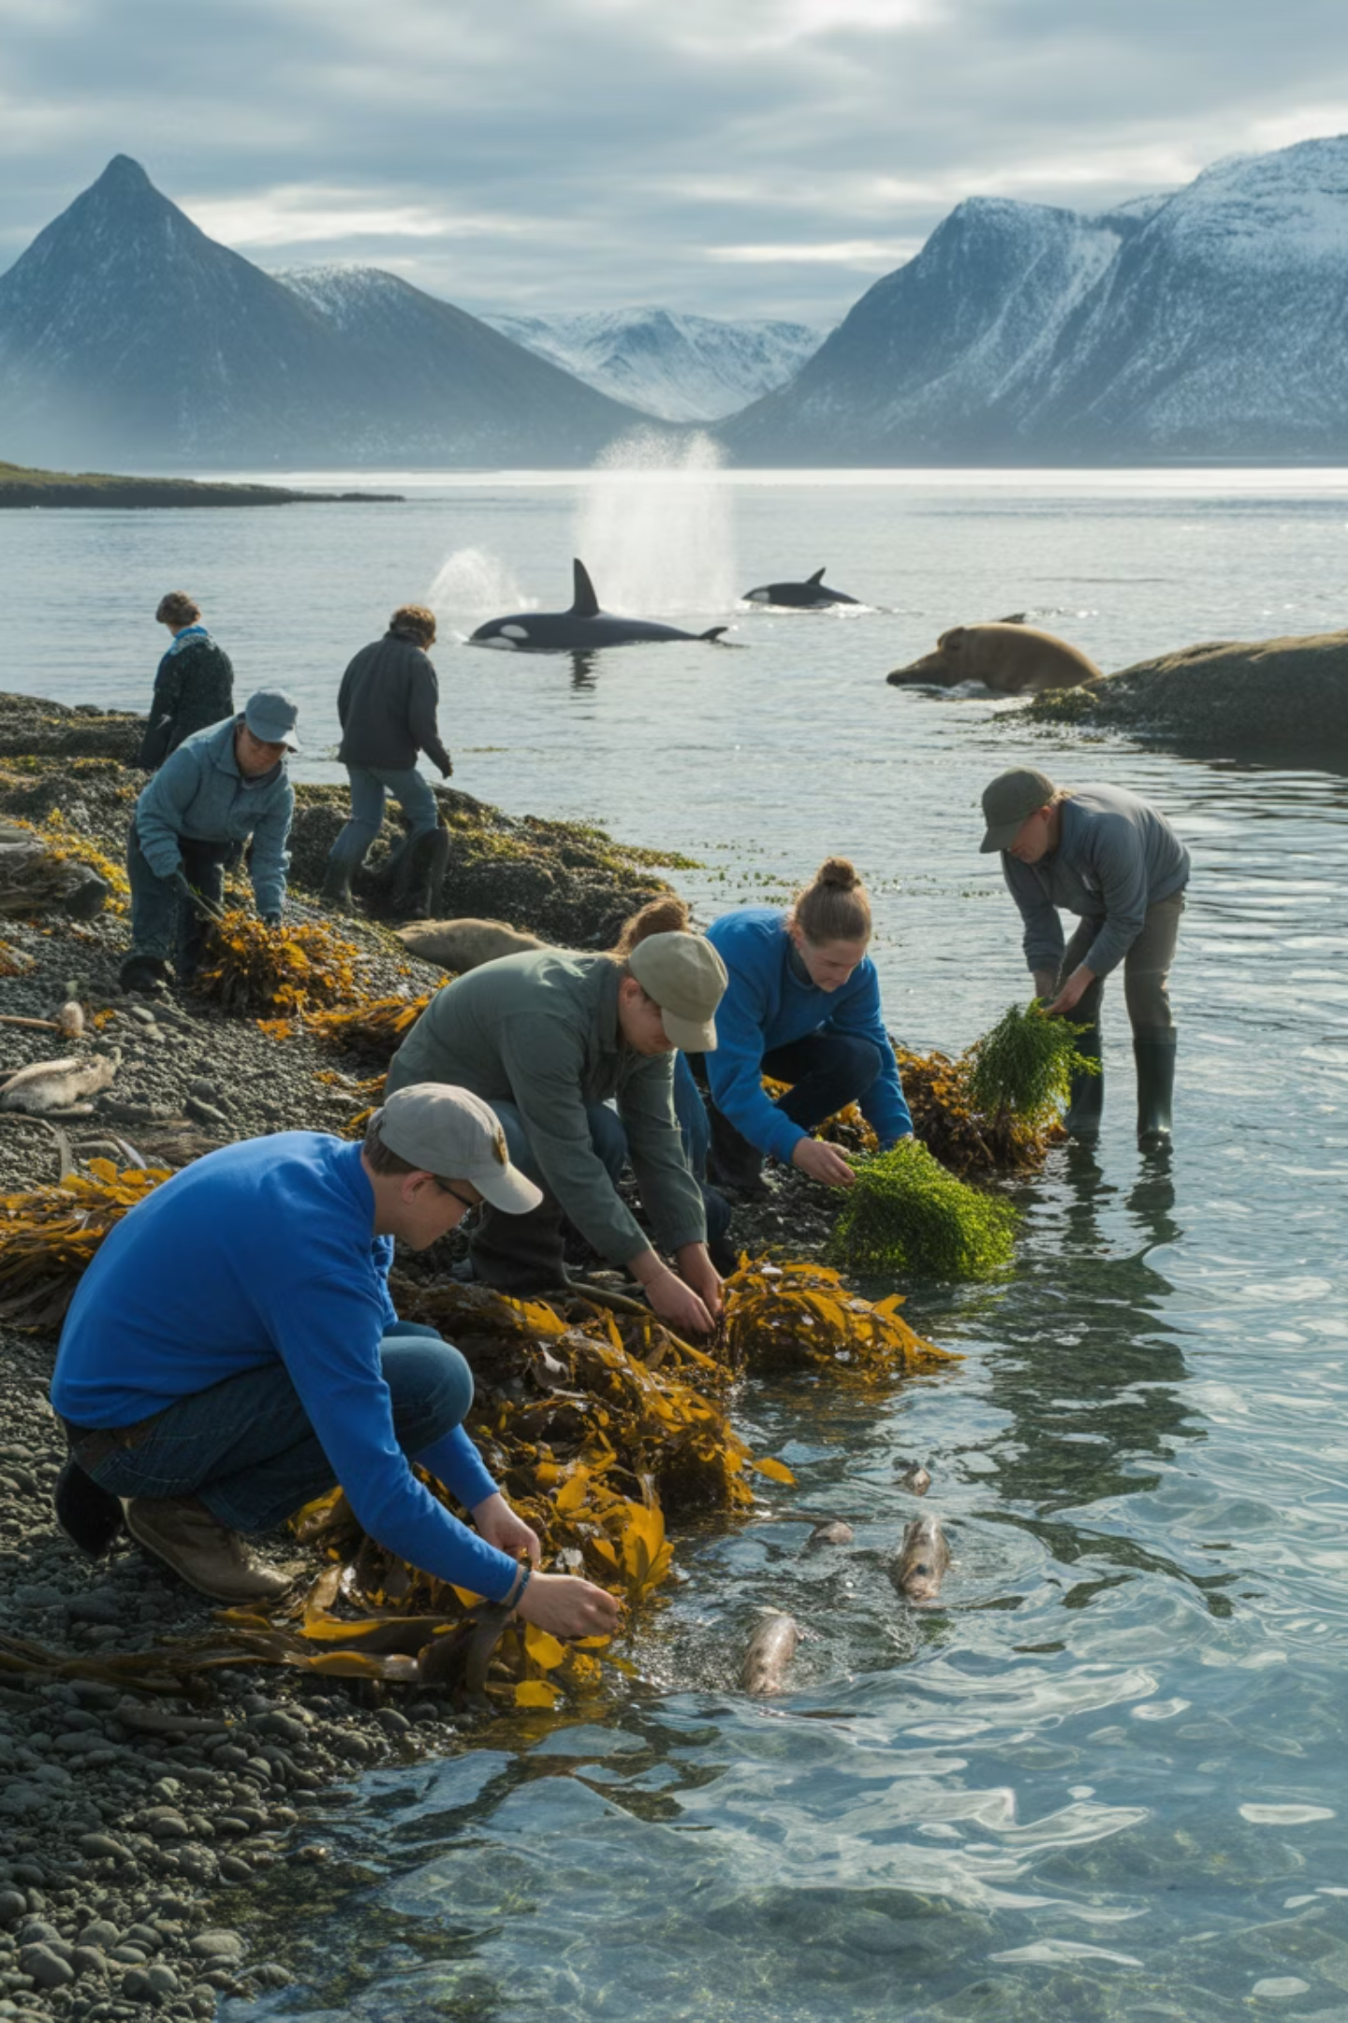
Integrating Advanced Science for Standards Derivation
Species Sensitivity Distributions (SSDs)
Biota-Sediment Accumulation Factors (BSAFs)
Statistical models estimating the concentration that protects a certain percentage of species, accounting for variability in responses to contaminants.
Ratios indicating how readily contaminants move from sediment into organisms, quantifying the transfer between environmental compartments.
Food-Web Models (FWMs)
Bioaccumulation Based Sediment Guideline Values (BBSGV)
Complex simulations of contaminant transfer and biomagnification through entire ecosystems, providing comprehensive views of exposure pathways.
Risk-based estimates that are protective of the food exposure pathway. They use Acceptable Daily Intake for receptors and bioaccumulation factors, ensuring protection for humans and wildlife consuming aquatic organisms.
These tools are critical for deriving the specific values within each quadrant of the Matrix Framework. For example, SSDs are used for SedS-directECO, while BBSGVs, BSAFs, FWMs are essential for deriving SedS-food standards.

Slide 7

Matrix Sediment Standards: Food Toxicity
Given the potential for over-conservatism and remediation challenges, for which contaminant classes would the initial development of Matrix Sediment Standards protective of food toxicity be most scientifically defensible and practically beneficial, please rank (1 = most).
60s entry + 60s discuss results
1 - Metals known to biomagnify
2 - Polycyclic Aromatic Hydrocarbons
3 - Polychlorinated Biphenyls
4 - Per- and Polyfluoroalkyl Substances
5 - All of the above
6 - Other

Slide 8

Implementing Matrix Framework: Challenges & Opportunities
Rank in order of highest to lowest importance the following considerations in developing and implementing the Matrix Sediment Standards Framework (1 = highest)?
60s entry + 60s share results
1 - Technical Hurdles: Limited data availability for many contaminants and species native to BC
2 - Practical Challenges: Discretionary matrix sediment standards may be a barrier for some practitioners
3 - Enhanced Protection: Comprehensive safeguards for BC's diverse aquatic ecosystems and peoples
4 - Scientific Advancement: Opportunity to pioneer innovative approaches to sediment management
5 - Societal Expectations: Given the challenges of modern society, holistic protection may not be feasible

Slide 9




Your Input: Shaping Holistic Protection
Participant insights
Scoping Plan
Your expertise will directly aid the development of scientifically defensible and practical standards for ecological protection
Roadmap for future research to support the collaborative development of a modern framework for sediment standards
SSTAC white paper
High-level summary of the Sediment Standards Project (Phase 1), including a synthesis of your input

Slide 10



Thank You!
Your Contributions Matter
Your expertise is vital as we work to modernize BC's sediment standards for comprehensive ecosystem protection.
Protecting Our Aquatic Ecosystems
Together, we're developing standards that safeguard aquatic ecological organisms and the predators that depend on them.
Contact SSTAC
For questions or additional input, please reach out to us. We appreciate your engagement in this important work.

